Slide 1
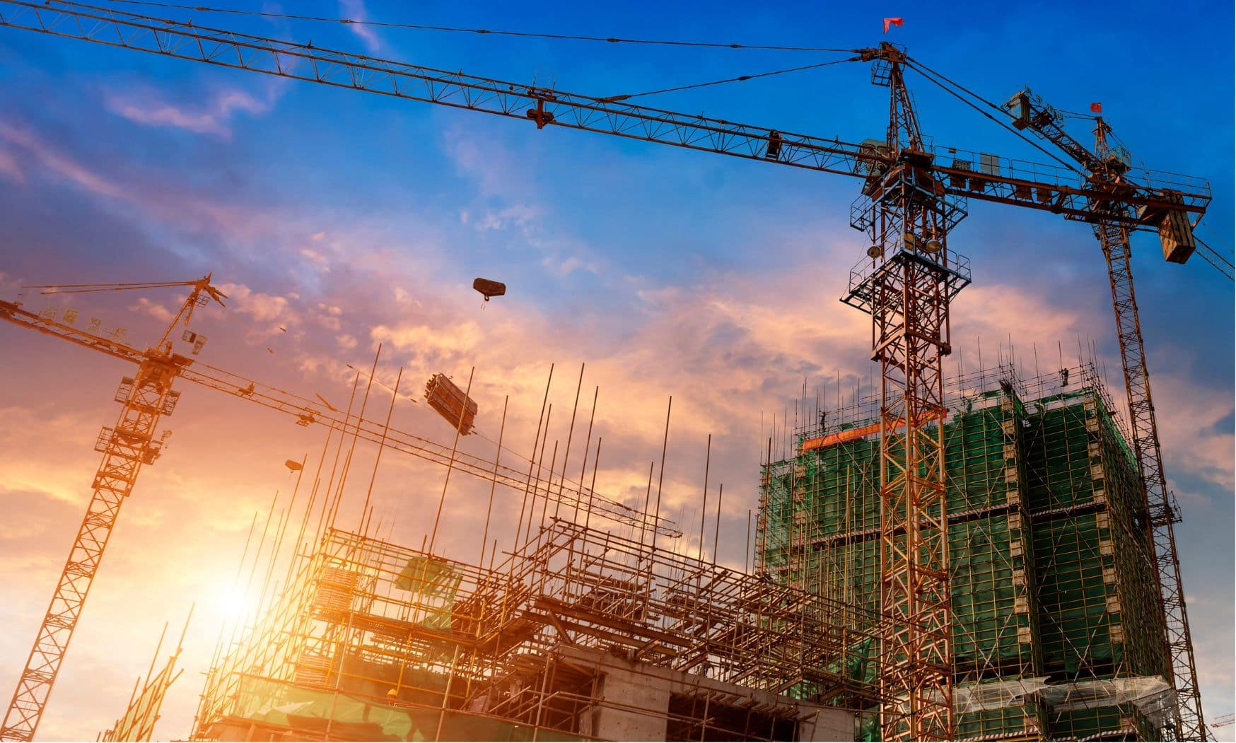
URBAN
CRAFT
CONSTRUCTION COMPANY PROFILE

Slide 2
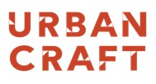
About Our Company
URBAN CRAFT Construction (UC) (Previously: Inertia Construction) is a well-established construction company since 2007 and is currently looking to expand in the field of construction in Egypt and internationally .
We are a construction contractor active in many markets and fields. We undertake many types of projects for public and private customers principally in Egypt.

Slide 3

Table of Content
About Our Company
Vision and Mission
Quality Control and Health
Delivered Projects
On-Going Projects
Community Sponsored

Slide 4


Our Vision And Mission
Our Vision
Our Mission
We intend to be the most successful and efficient construction company, by providing superior and quality project management and buildings services.
To Exceed customer and employee expectations by providing superior work delivery in all aspects of quality and budget.

Slide 5
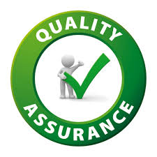
Quality Control and Assurance
Objective
Quality Plan is intended to set-up procedures and practices, which will ensure the implementation of the contractual requirements, avoid, and prevent any nonconformance to the contract to ensure that client’s specifications are met.
The Quality Plan shall:
Provide guidelines to ensure that all submittals comply with the project requirements.
Plan shall describe actions related to the physical characteristics of the approved materials and processes.
Mean the correct execution of works/ activities which shall be ensured by approved ITP (Inspection and Testing Plan) and Method Statement.
By proper implementation of the project specifications shall be verified thru respective inspection and Testing Plan

Slide 6
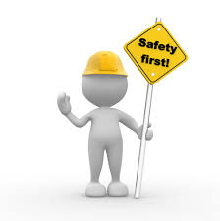
Health and Safety
Objective
HSE Plan is to achieve Zero Incidents for the Project.
Identification of potential safety hazards, prompt implementation of corrective actions with input from supervisors and employees.
Conducting regular audits/inspections of the safety procedures implementation.
Commitment to provide adequate resources to fulfill the HSE obligations.
Providing employees with necessary and approved personal protective equipment, and enforcing their use.
Promptly responding to any proposed recommendation with respect to safety or fire protection.
Overseeing the orientation and education of supervisors, employees and subcontractors regarding safety plans.
Monitoring safety performance

Slide 7
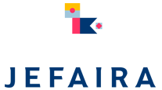
On-Going Projects
Phase 4
132 M EGP
Main Gate & Spine
36 M EGP
Phase 1
450 M EGP
Phase 2
45 M EGP
Gas Station
9 M EGP
Beach Excavation and Soil Investigation
10 M EGP

Slide 8
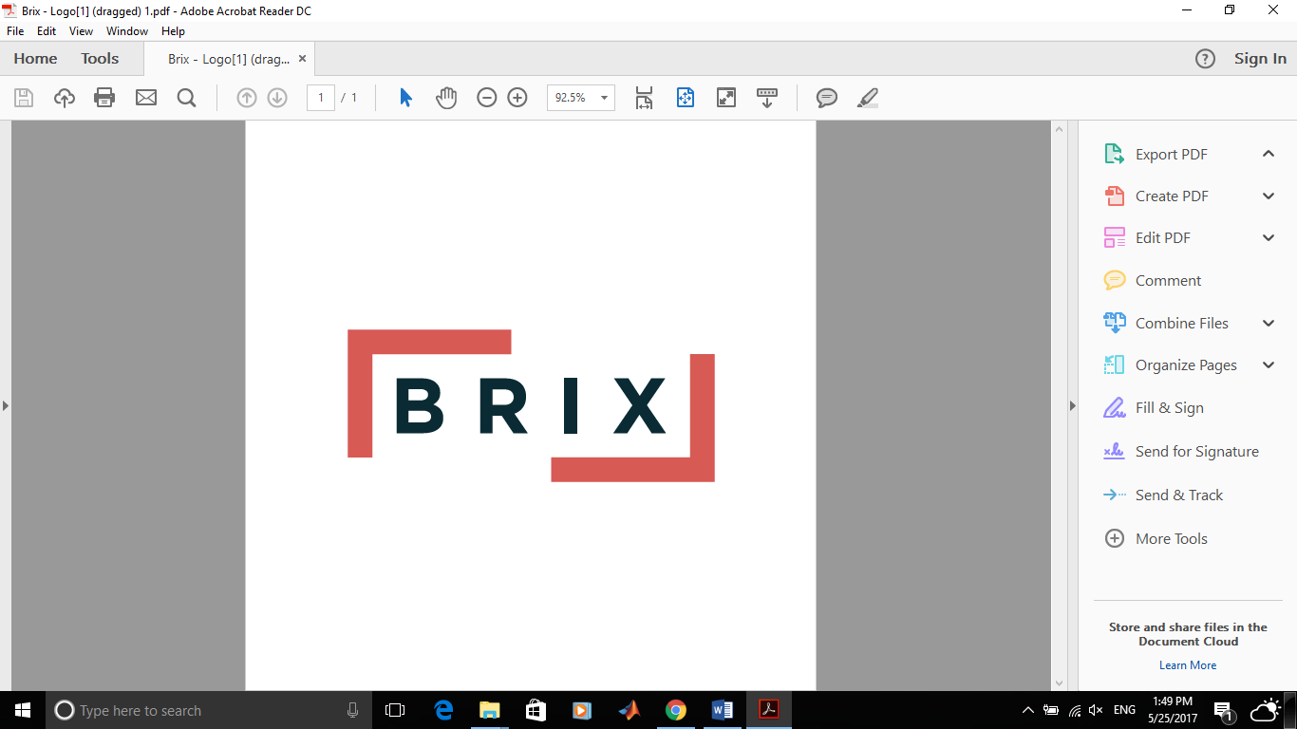
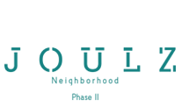


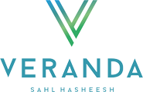
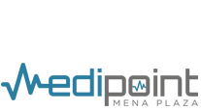
On-Going Projects
Phase 1 & 2
1.3 B EGP
Phase 3 & 4
1 B EGP
650 M EGP
479 M EGP
220 M EGP
150 M EGP
120 M EGP

Slide 9
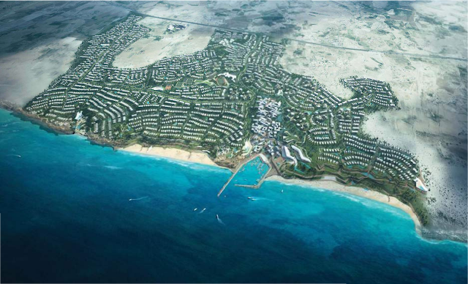
Jefaira
Project Description:
The Project consist of various phases which each phase has a unique design with a different concept which is considered a challenge to construct. Jefaira stretches across 5.5 million square meters offering a fully integrated beach town master planned to preserve natural topography.
Our scope of work : Construction for all project features.
Infrastructure & Utilities (Sewage).
MEP including HVAC & FF systems.
Superior Finishes
Phase 1 & 2 & 4 & Gas Station & Main Gate
Client: Inertia Properties
Location: Alexandria Road, KM 200
Project value: Expected 2.2 Billion EGP
Project Status: On-Going

Slide 10
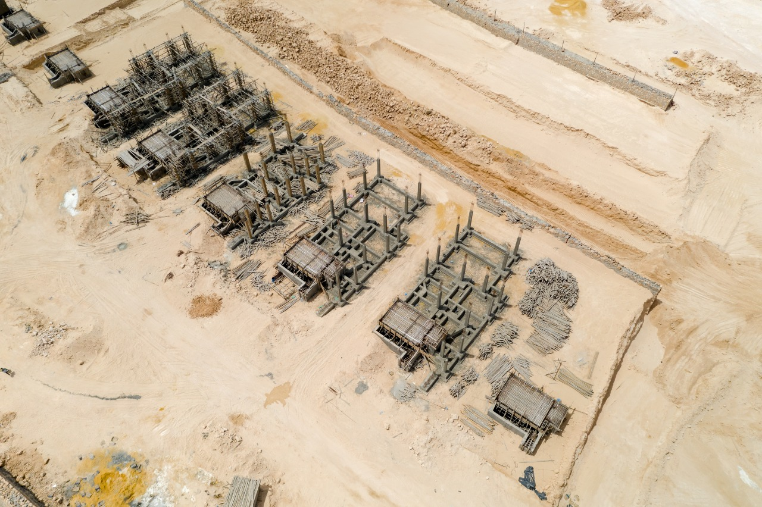
Construction Updates

Slide 11
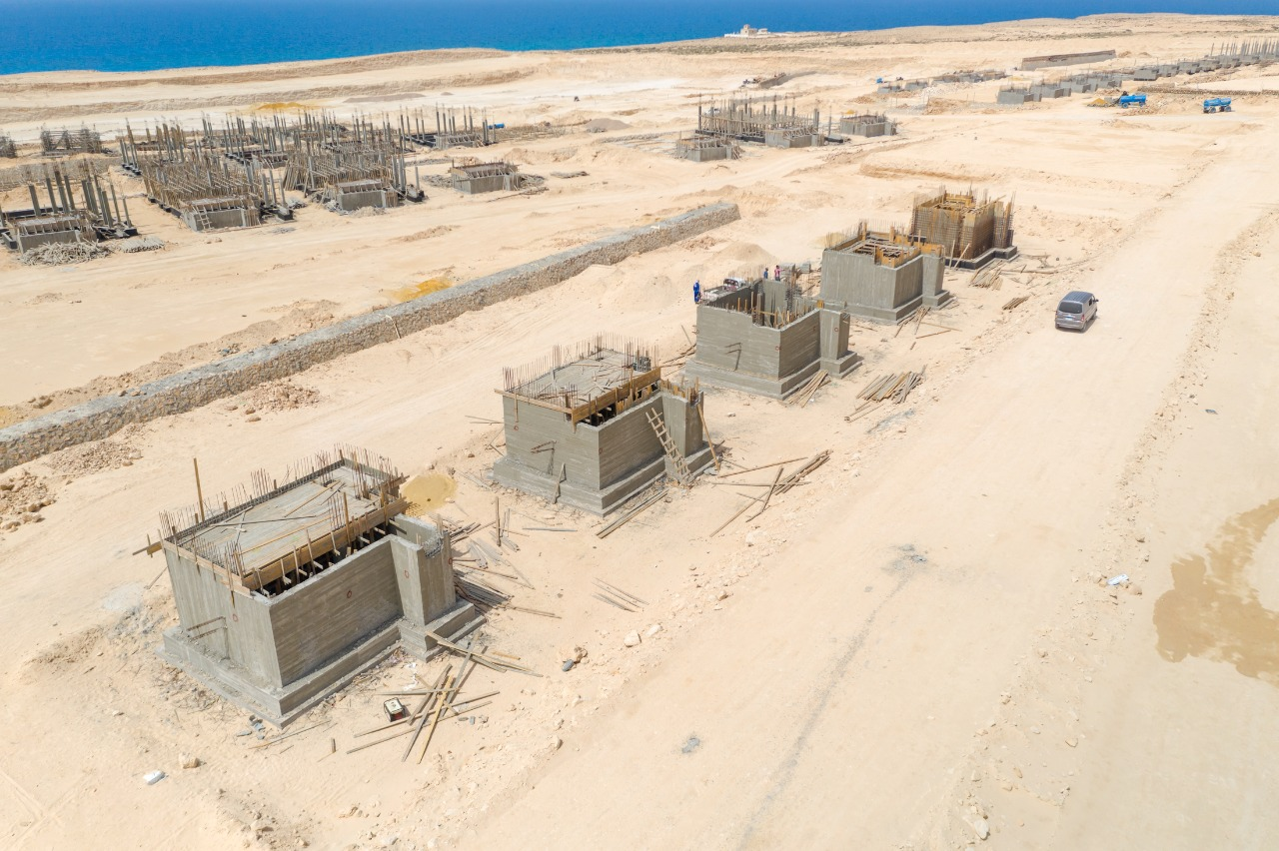
Construction Updates

Slide 12
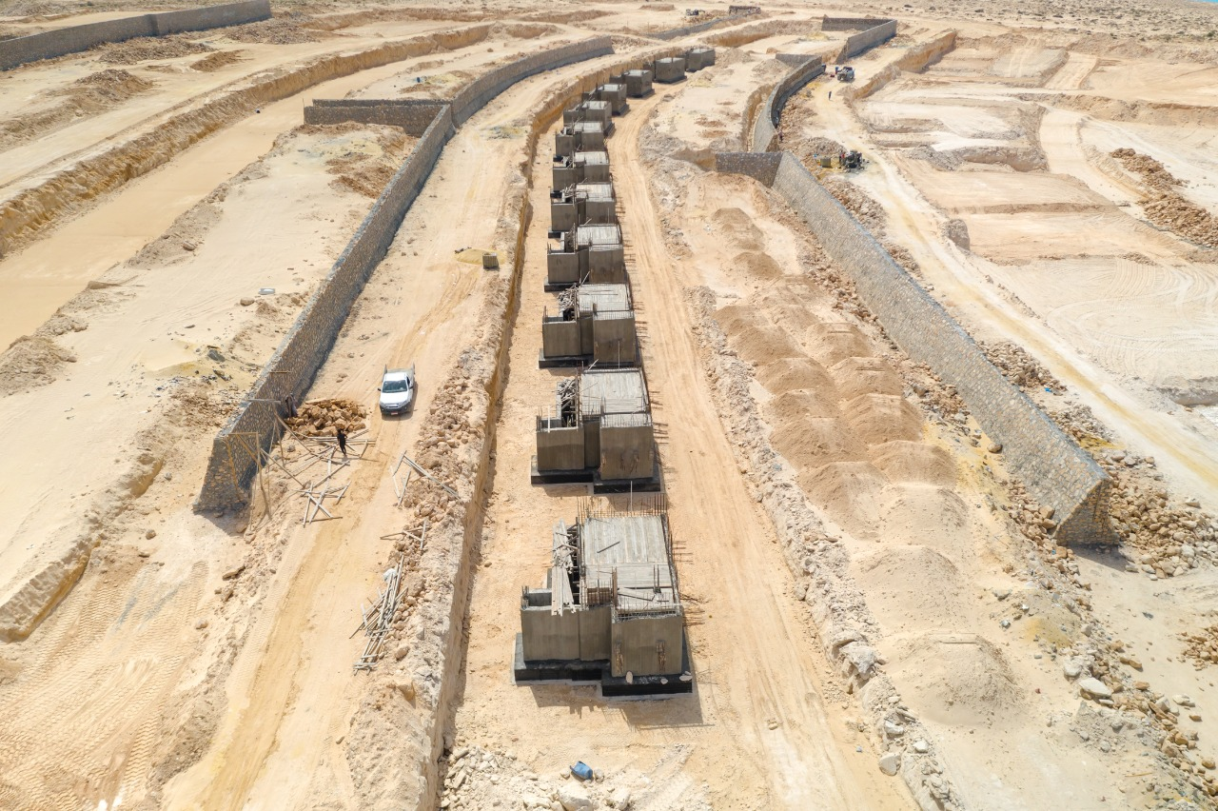
Construction Updates

Slide 13
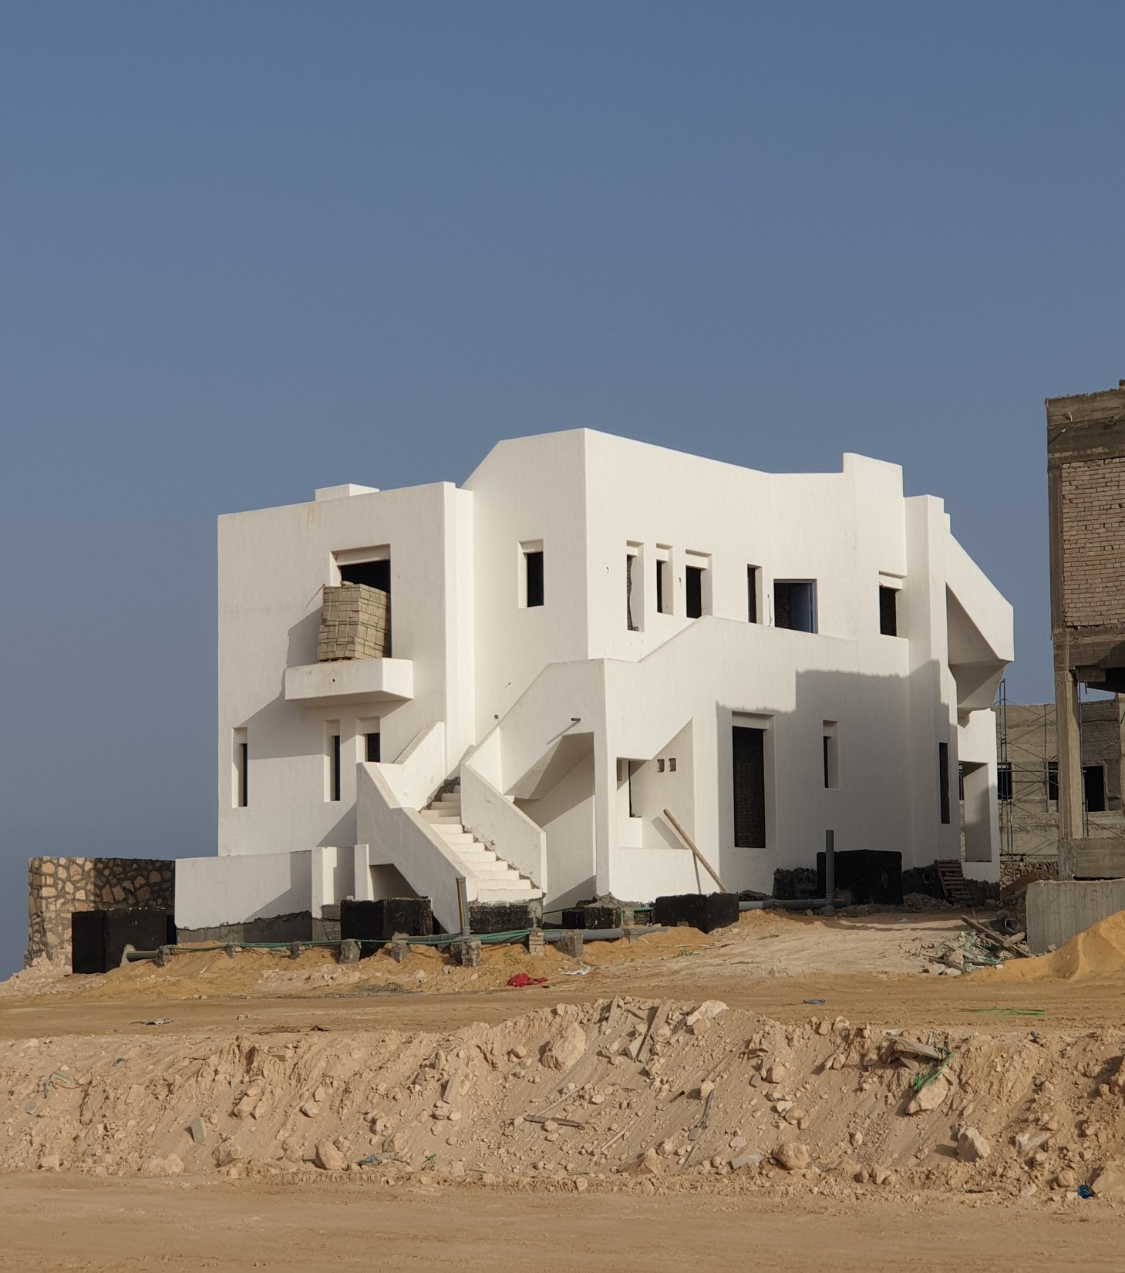
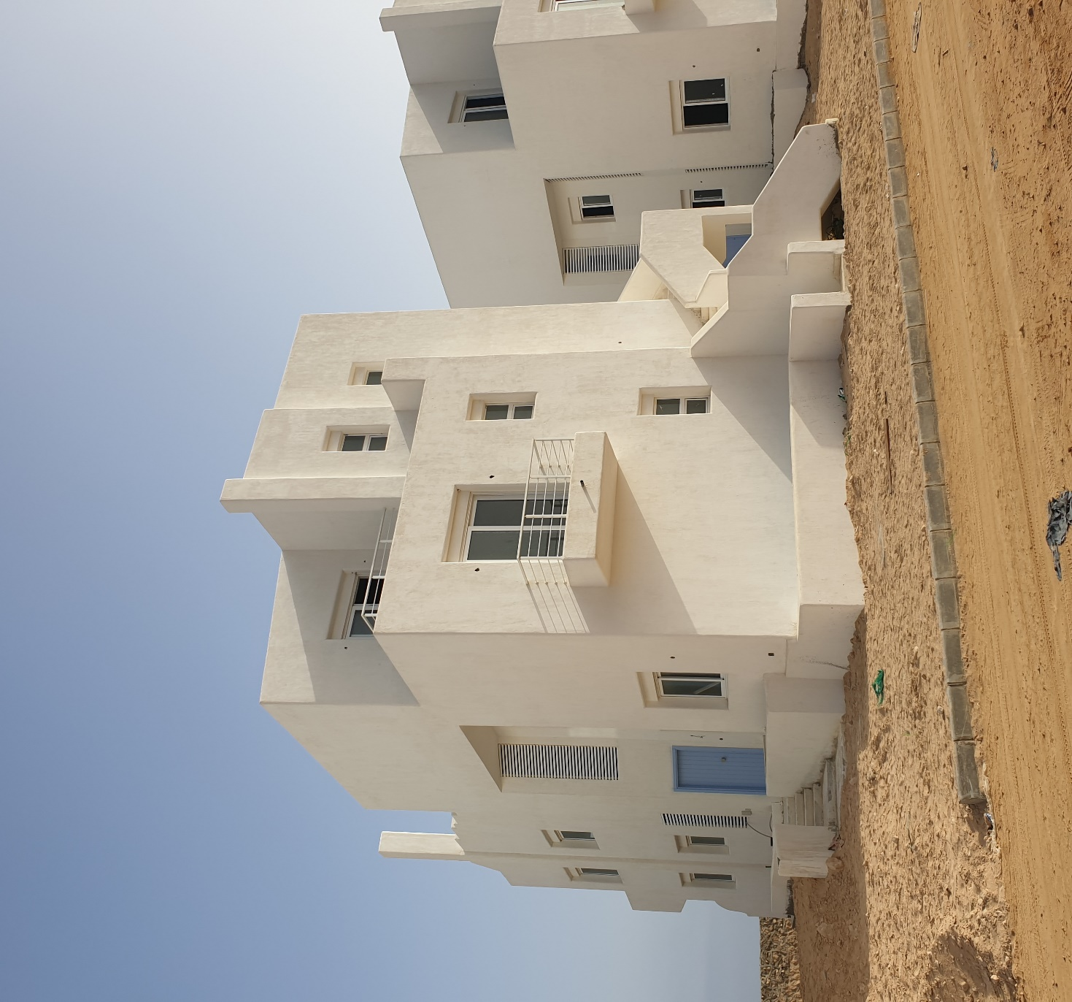
Construction Updates

Slide 14
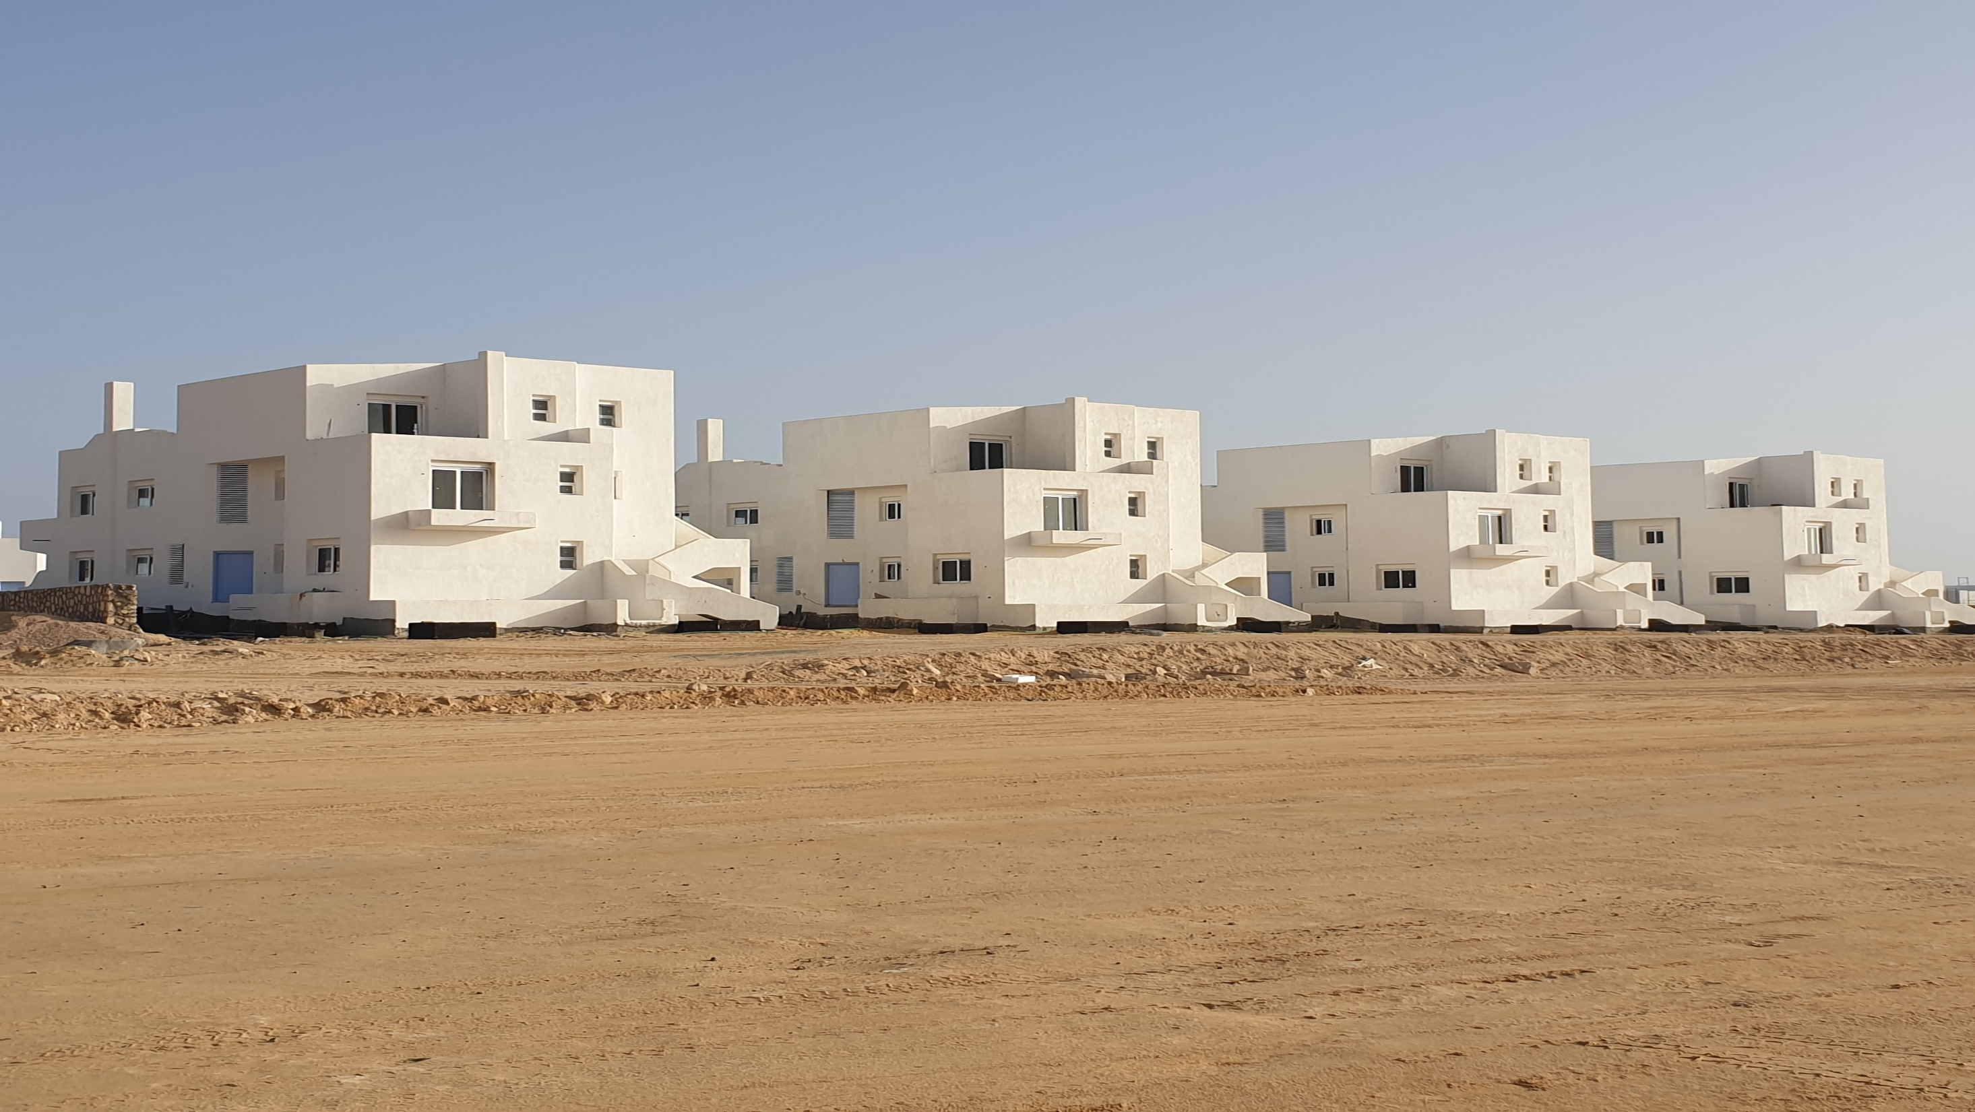
Construction Updates

Slide 15
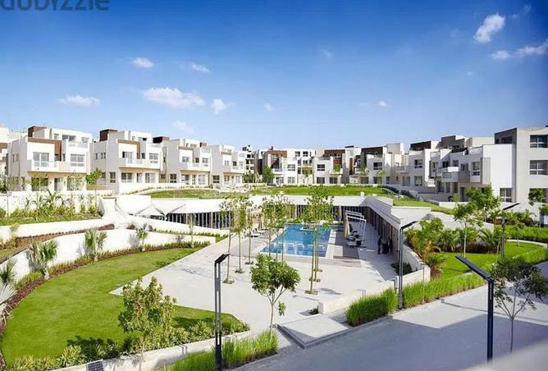
Soleya
Project Description:
The Project consist of 165 residential units, with 77% greenery and a great view of the pyramids of Giza.
Our scope of work : Construction for all project features.
Infrastructure & Utilities (Sewage).
MEP including HVAC & FF systems.
Superior Finishes.
Client: Inertia Properties
Location: Cairo-Alexandria Road, Egypt
Project value: 650 Million EGP
Project Status: On-Going

Slide 16
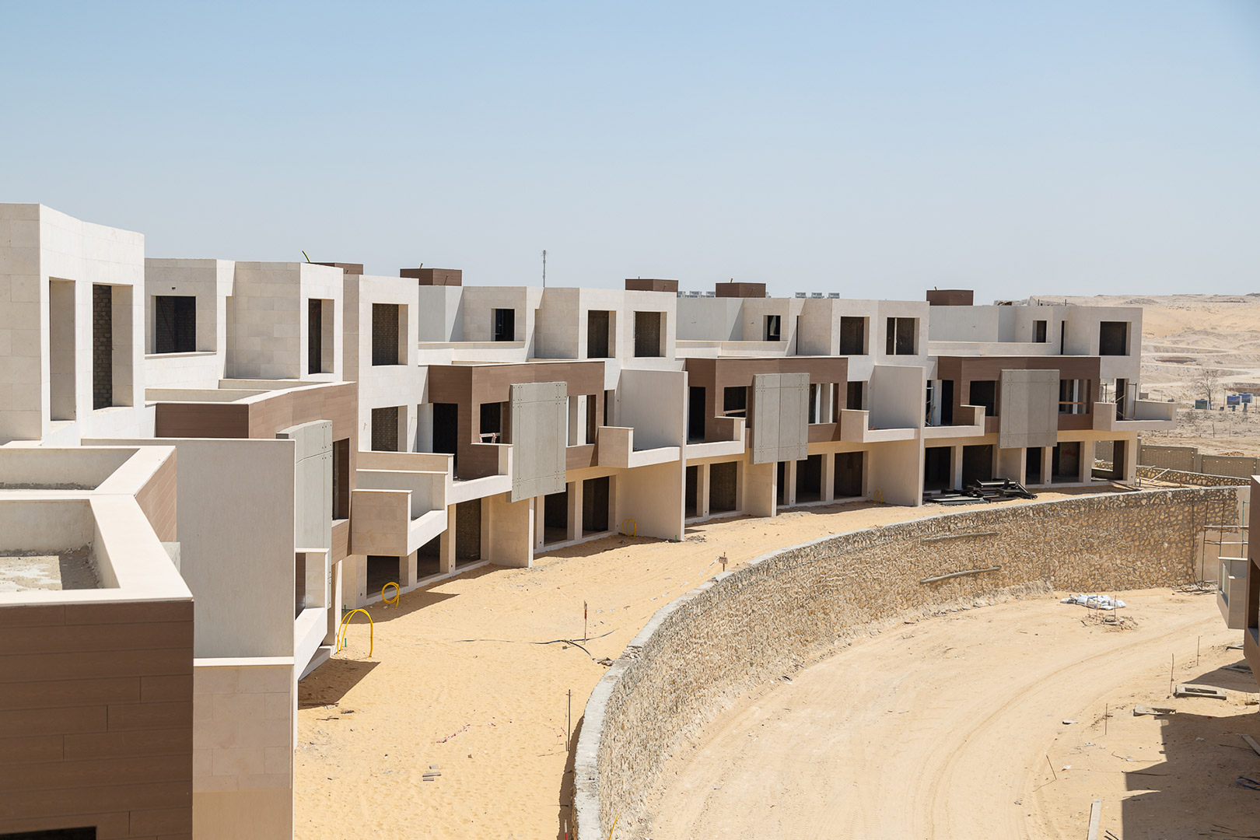
Construction Updates

Slide 17
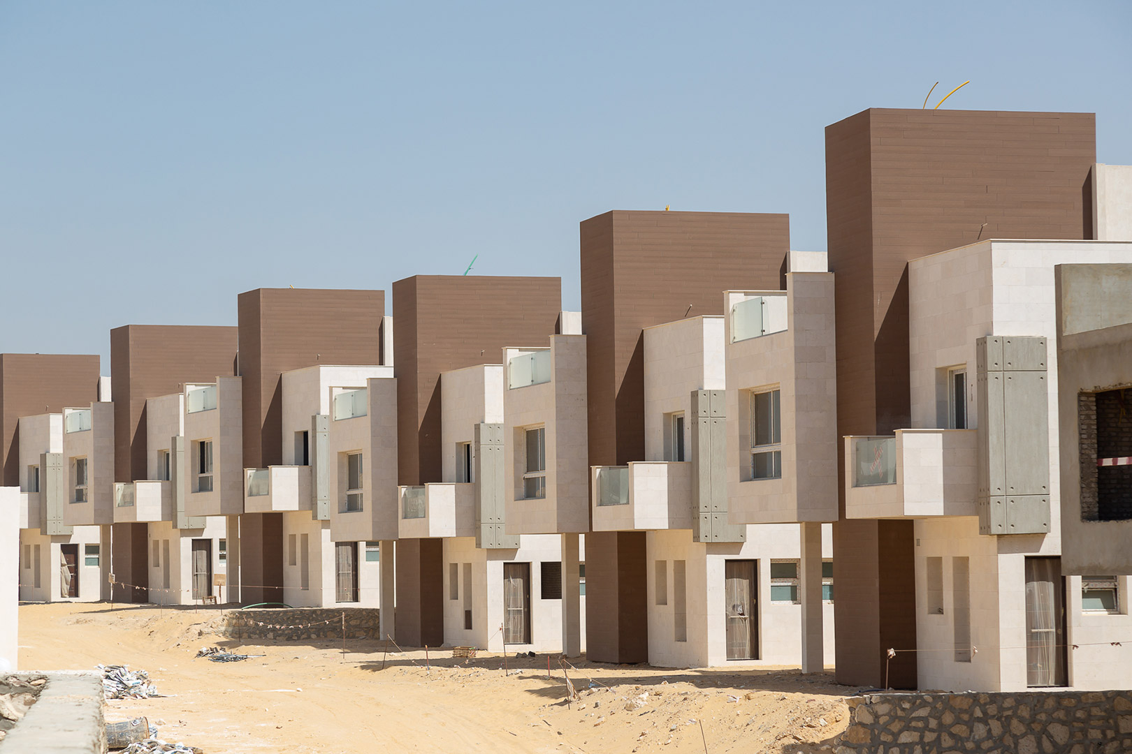
Construction Updates

Slide 18
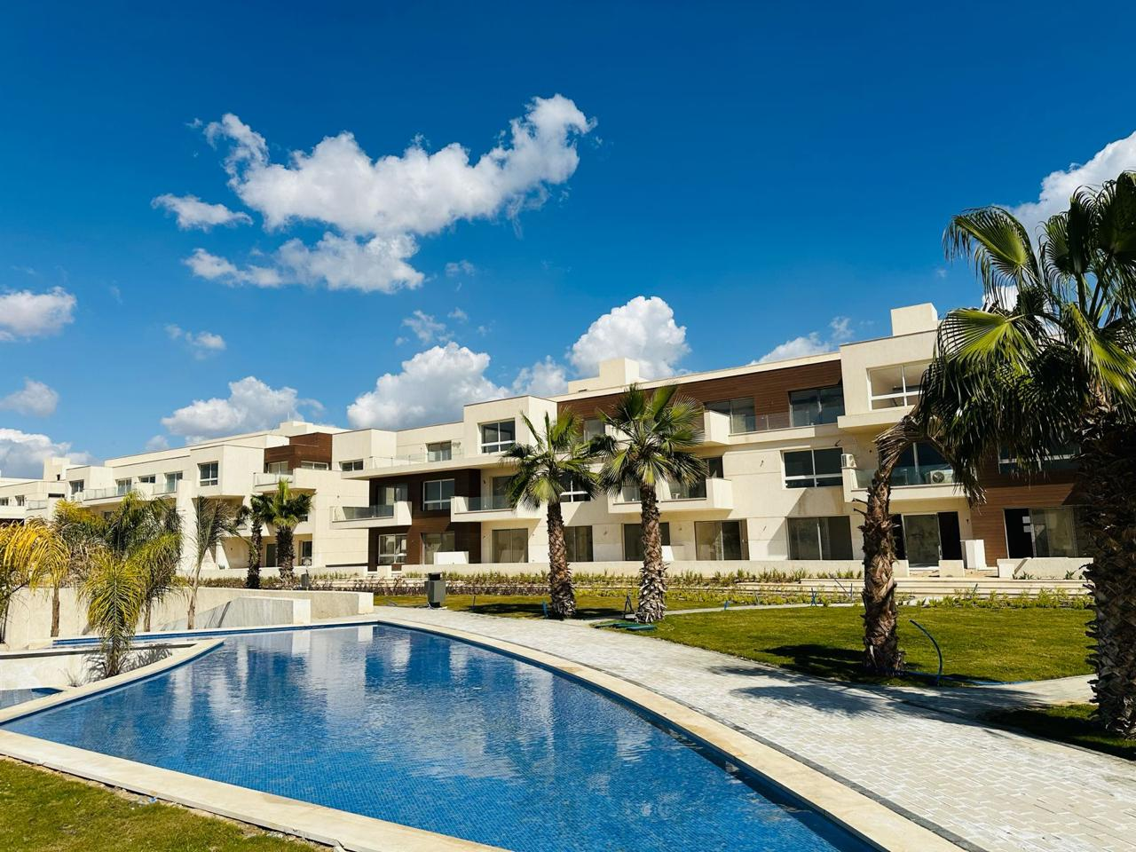
Construction Updates

Slide 19
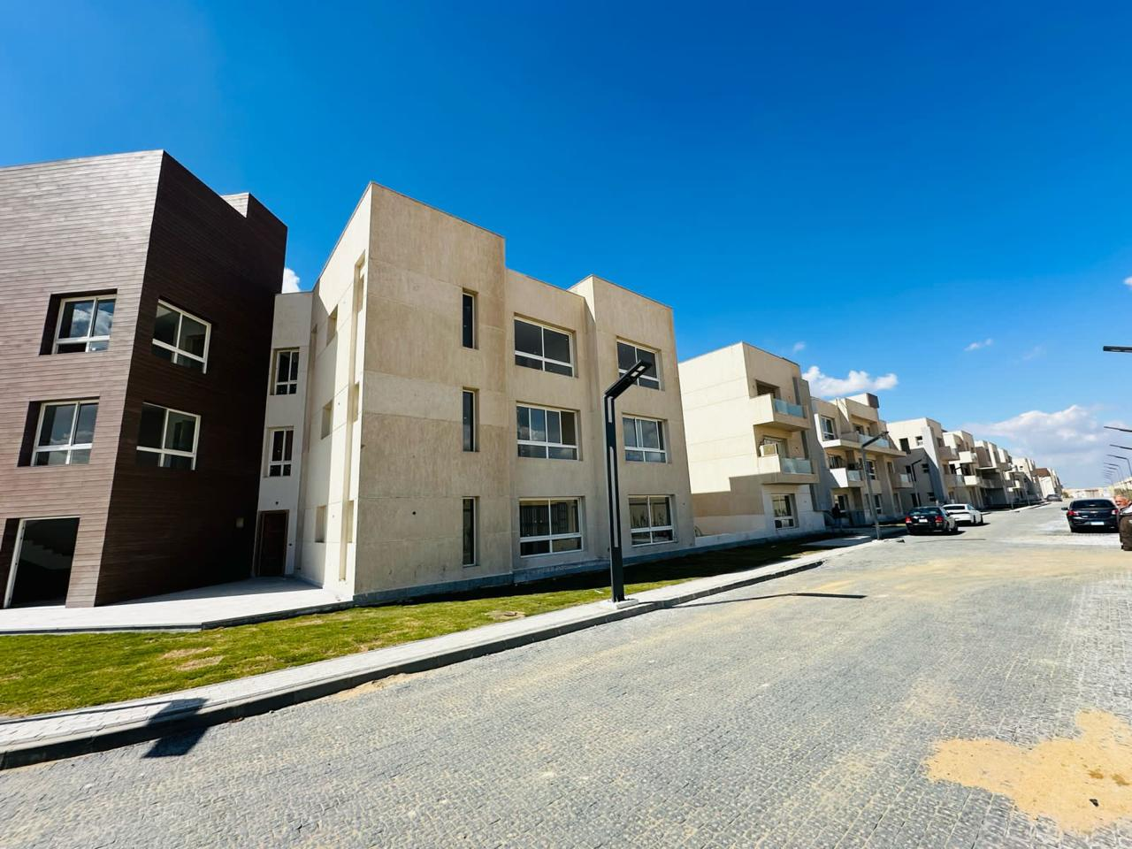
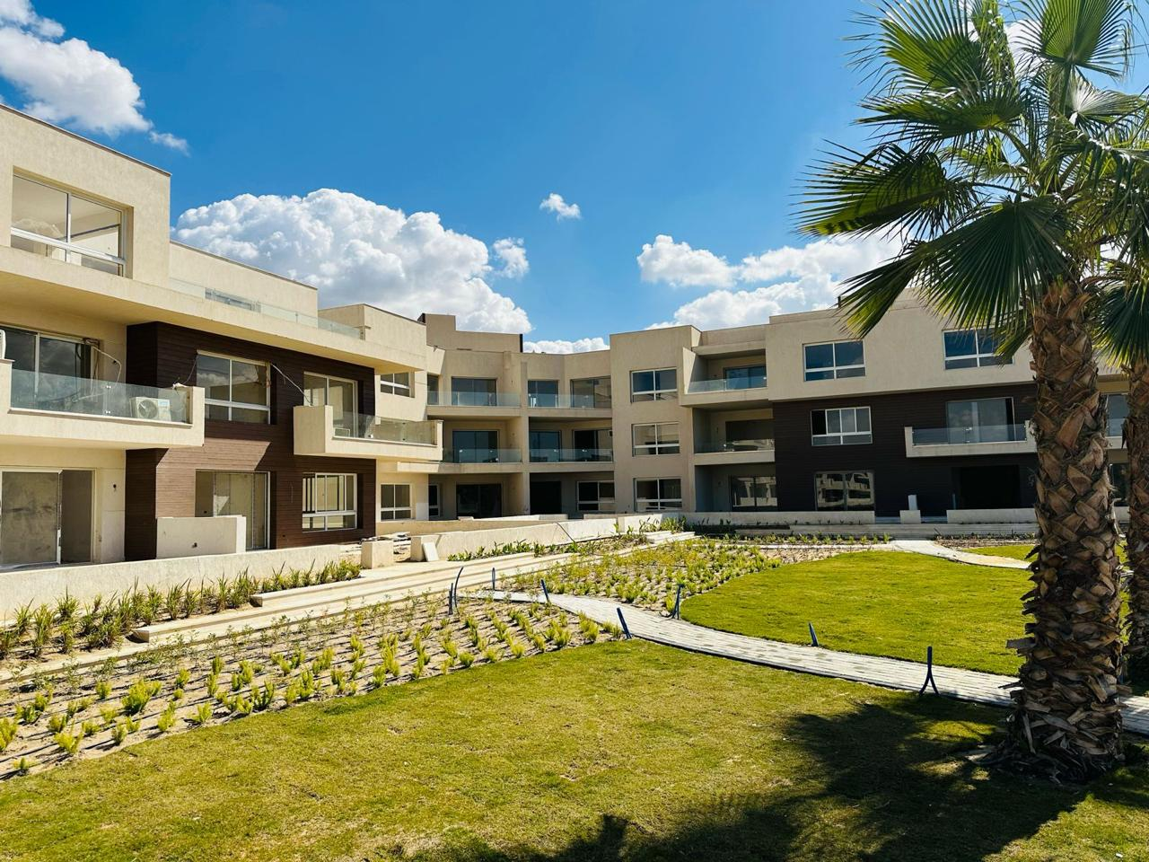
Construction Updates

Slide 20
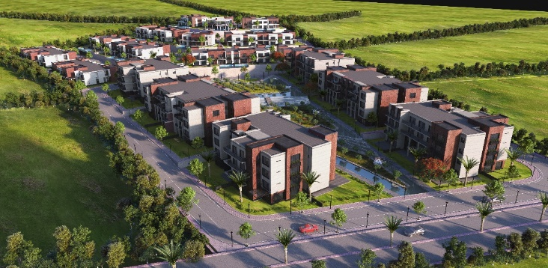
BRIX
Project Description:
The Project consist of 73% of open spaces and greenery, 17 buildings , all having a beautiful view of the lush landscape and natural colors.
Our scope of work : Construction for all project features.
Infrastructure & Utilities (Sewage).
MEP including HVAC & FF systems.
Superior Finishes.
Client : Inertia Properties
Location: Cairo-Alexandria Dessert Road, Egypt.
Project value: 479 Million EGP
Project status: On-Going

Slide 21
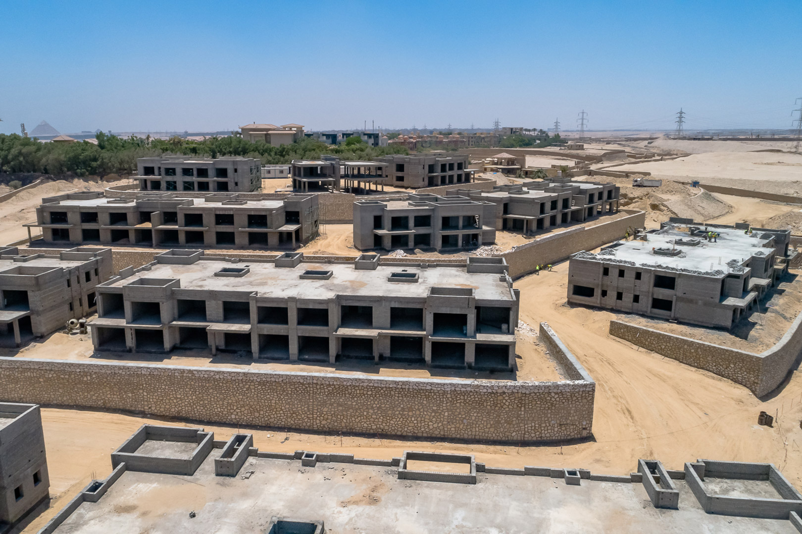
Construction Updates

Slide 22
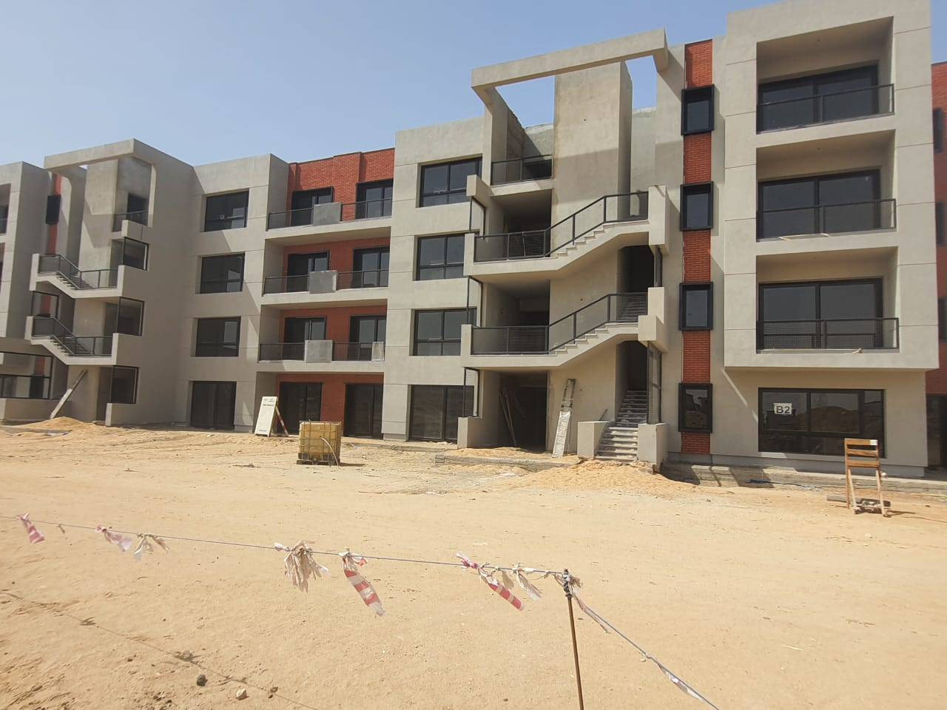
Construction Updates

Slide 23
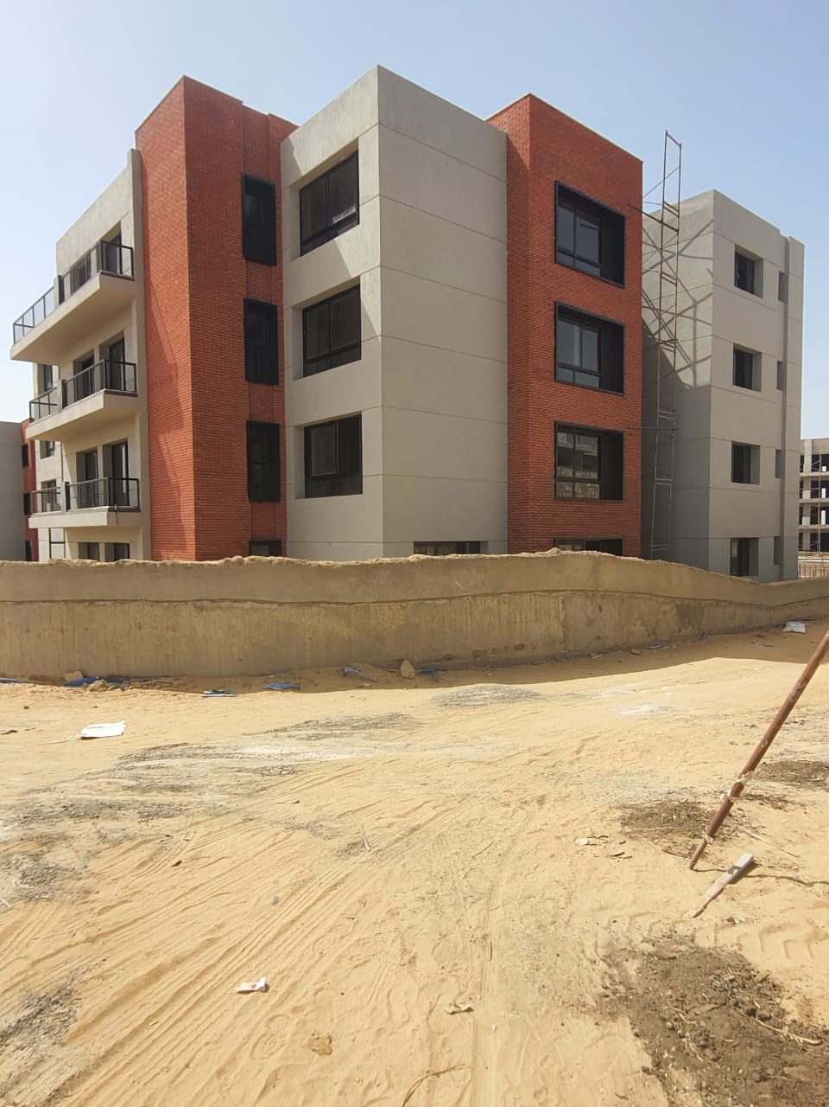
Construction Updates

Slide 24
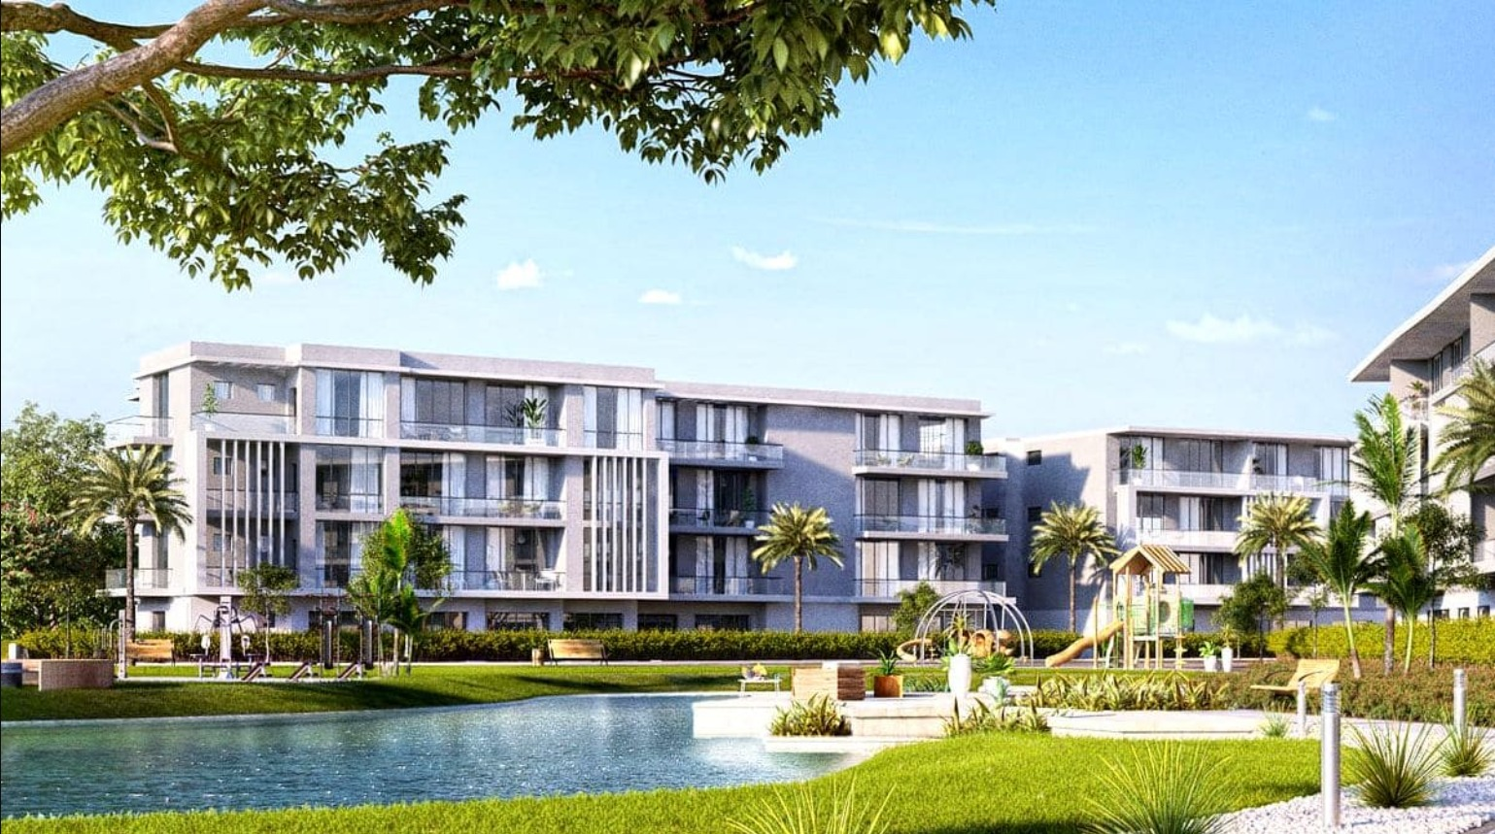
Joulz
Project Description:
The Project consists of residences ranging stand-alone, twin houses, town houses and apartments making up to 30% of development land area. Project is divided in to 4 unique phases with a total of 1,150 residential units, in addition to a project span boulevard.
Our scope of work : Construction for all project features.
Infrastructure & Utilities (Sewage).
MEP including HVAC & FF systems.
Superior Finishes.
Project Management
Client: Inertia Properties/SPANZ
Location: Cairo-Alexandria Desert Road
Project value: Phase 1 & 2 - (1.3 Billion EGP)
Phase 3 & 4 - (1 Billion EGP)
Project Status: Phase 1 & 2 Completed
Phase 3 & 4 On Going

Slide 25
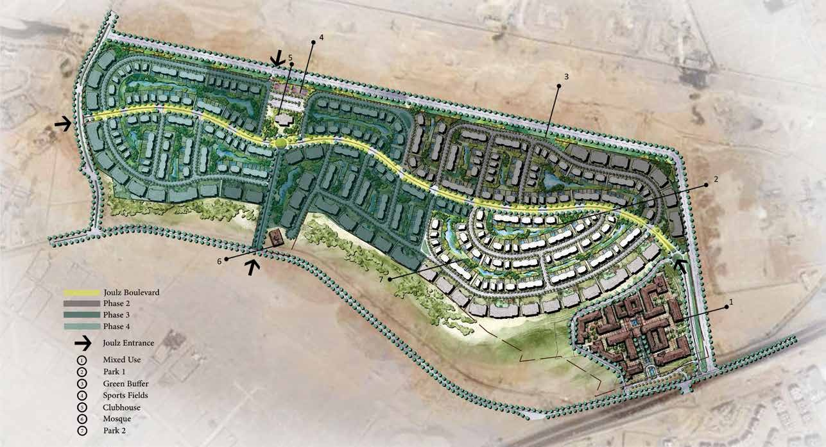
Construction Updates

Slide 26
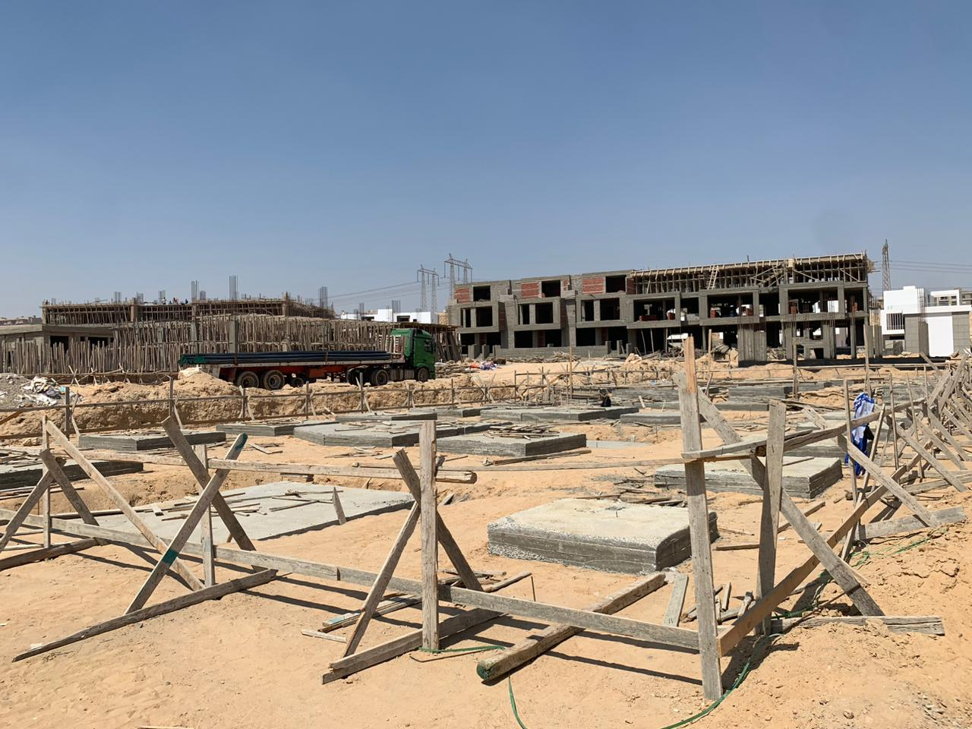
Construction Updates

Slide 27
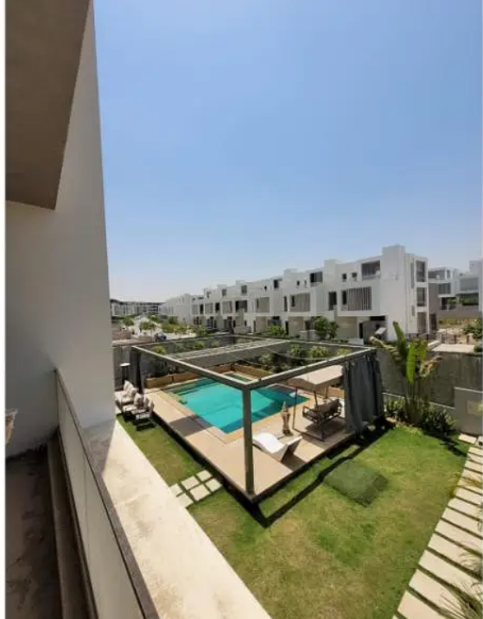
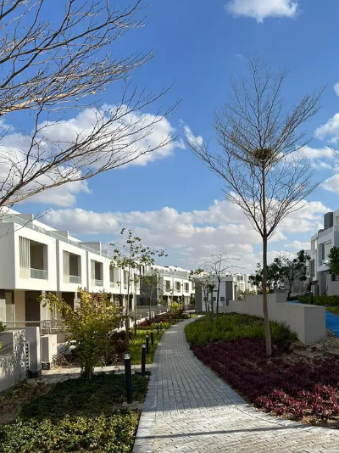
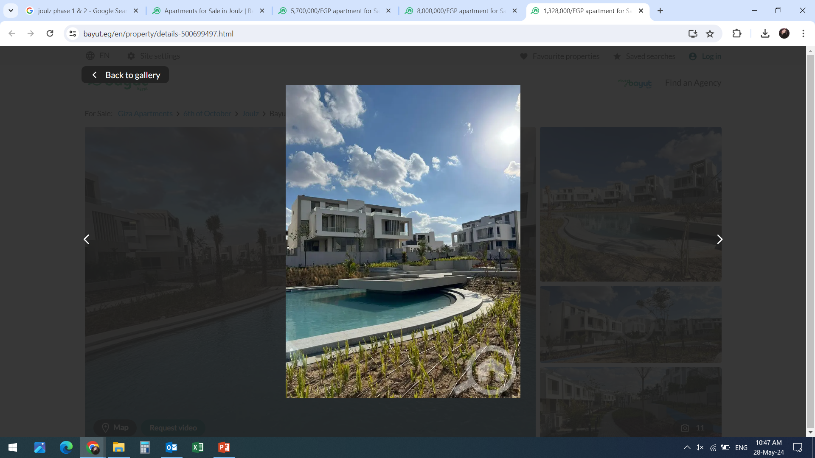
Construction Updates

Slide 28
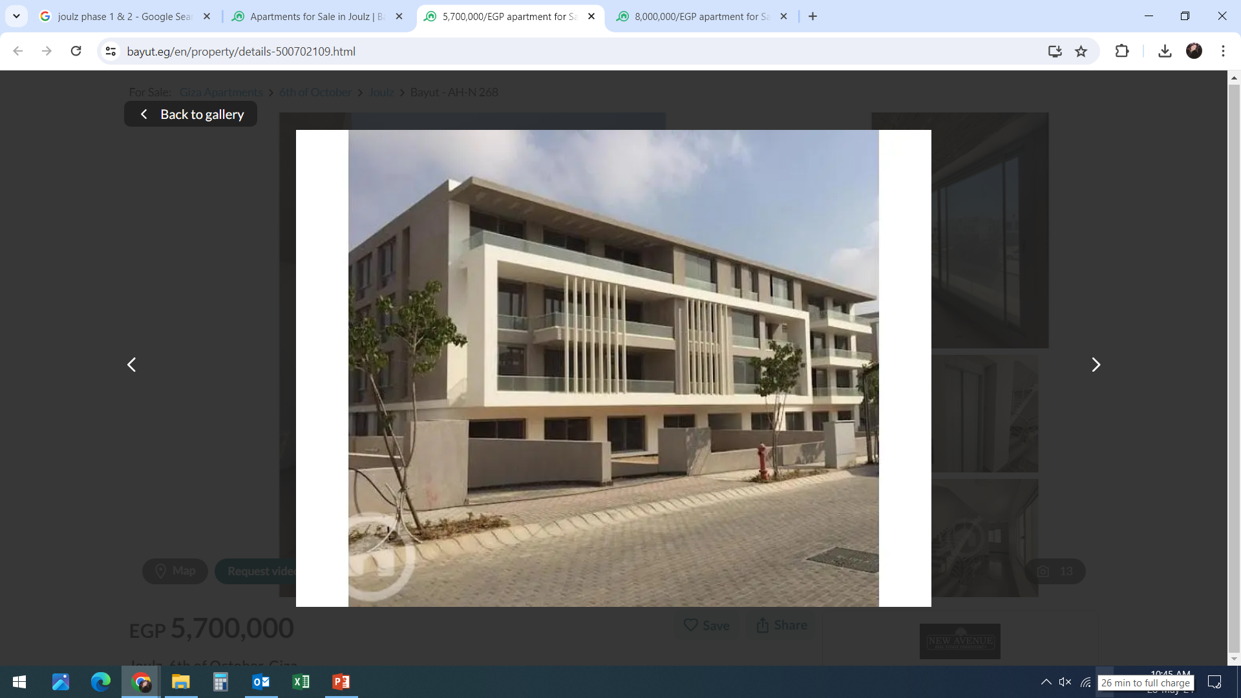
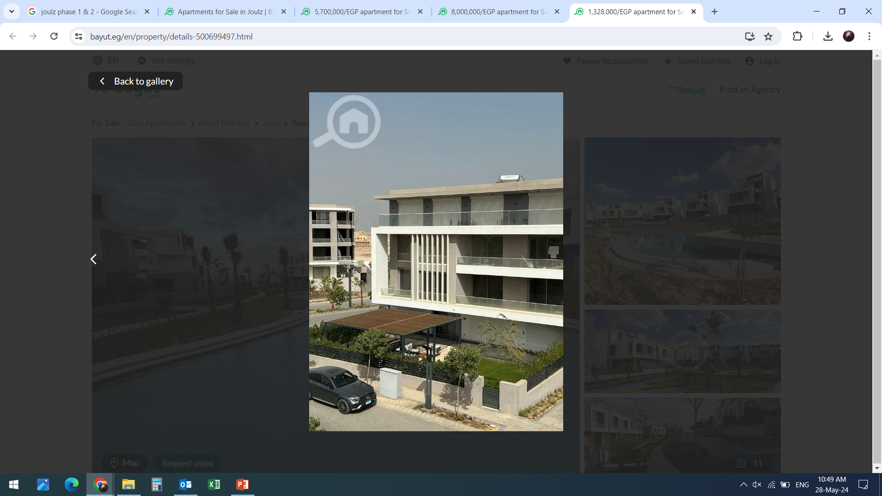
Construction Updates

Slide 29
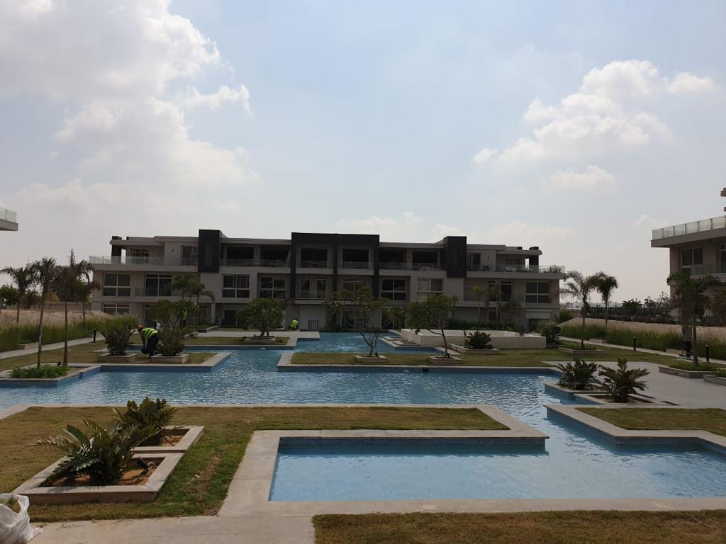
West Hills
Project Description:
First-row ticket to a panoramic scene of the pyramids, the compound is equipped with all types of modern facilities for all family members.
Our scope of work : Construction for all project features.
Infrastructure & Utilities (Sewage).
MEP including HVAC & FF systems.
Superior Finishes.
Client : Inertia Properties
Location: Cairo-Alexandria Dessert Road, Egypt.
Project value: 78 Million EGP
Project status: Delivered

Slide 30
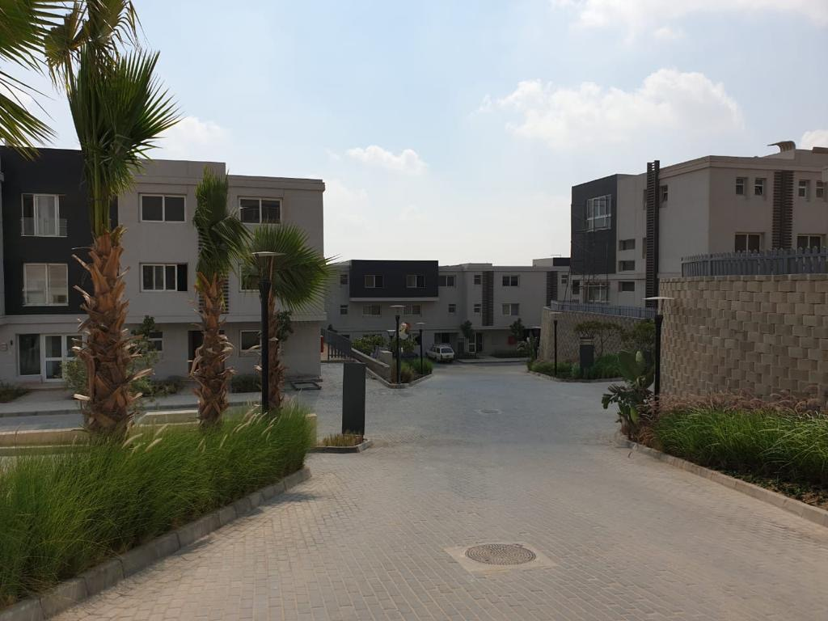
Construction Updates

Slide 31
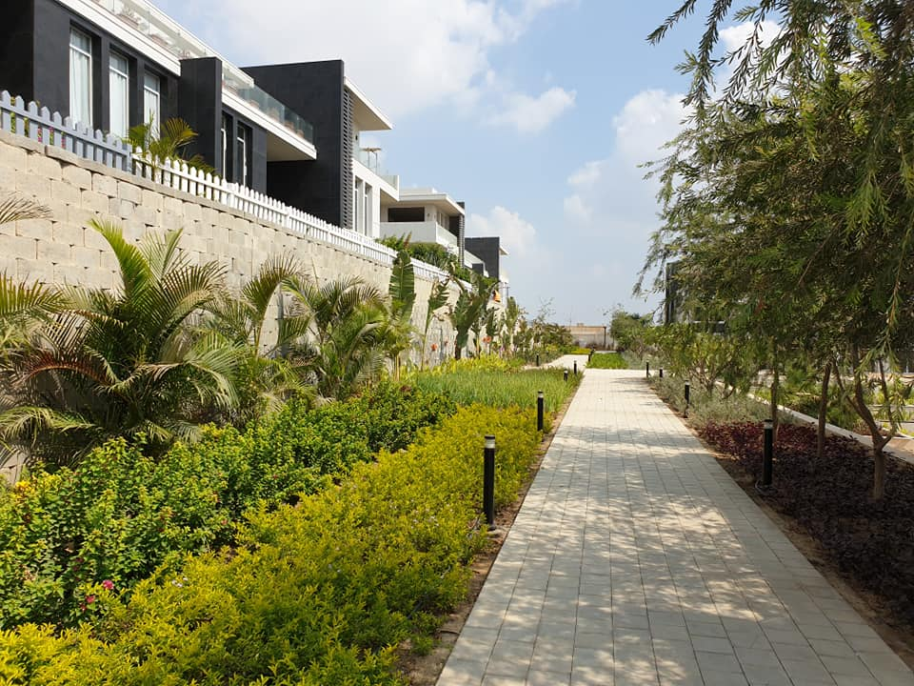
Construction Updates

Slide 32
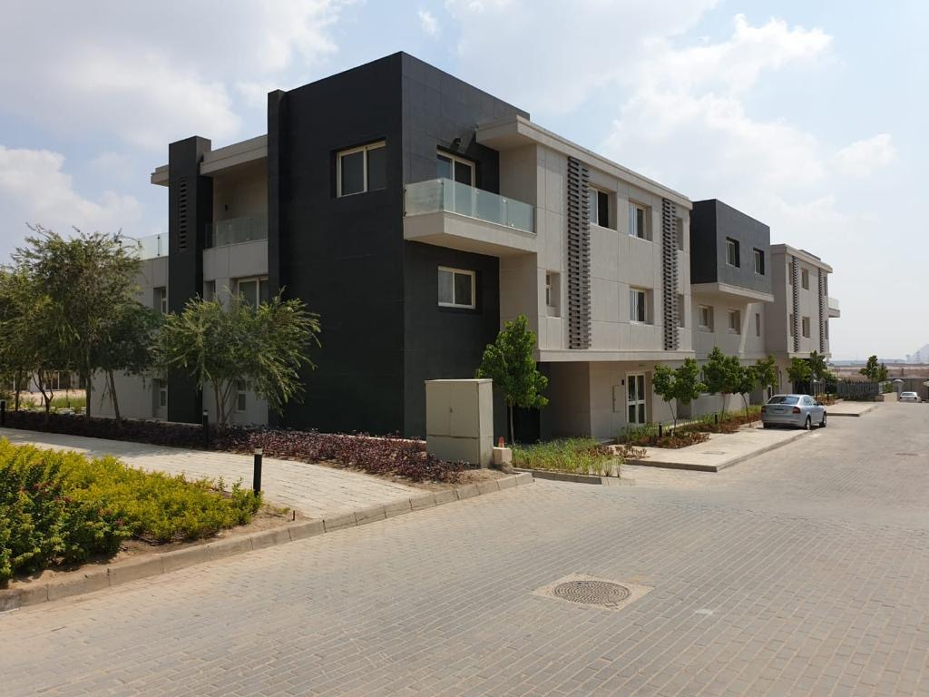
Construction Updates

Slide 33
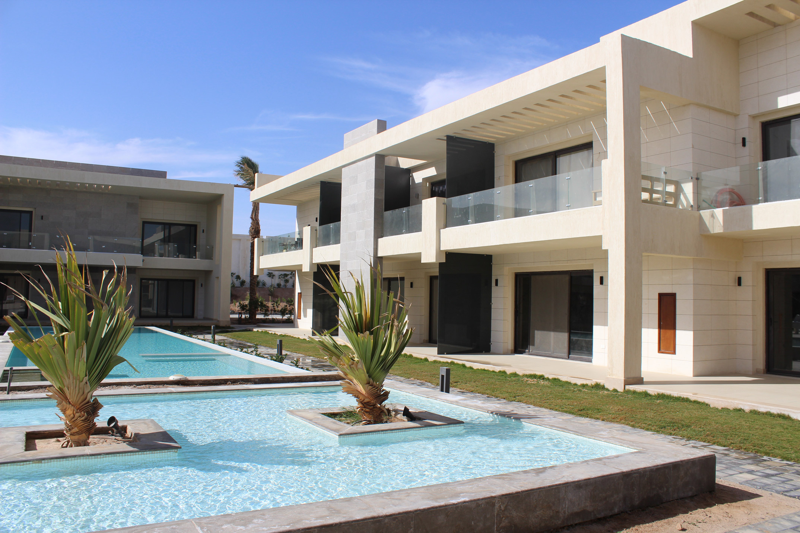
G-Cribs
Project Description :
The project is built on 21,500m2 (Phase 1) & 25,000m2 (Phase 2)and consists of residential units and a clubhouse and 7 heated Swimming pools.
Our scope of work : Construction for all project features.
Infrastructure & Utilities (Sewage).
MEP including HVAC & FF systems.
Superior Finishes.
Client: Inertia Properties
Location: El-Gouna , Red Sea, Egypt.
Project status: Delivered
Project value: Phase 2 220Million EGP (Delivered)
Phase1 60 Million EGP (Delivered)

Slide 34
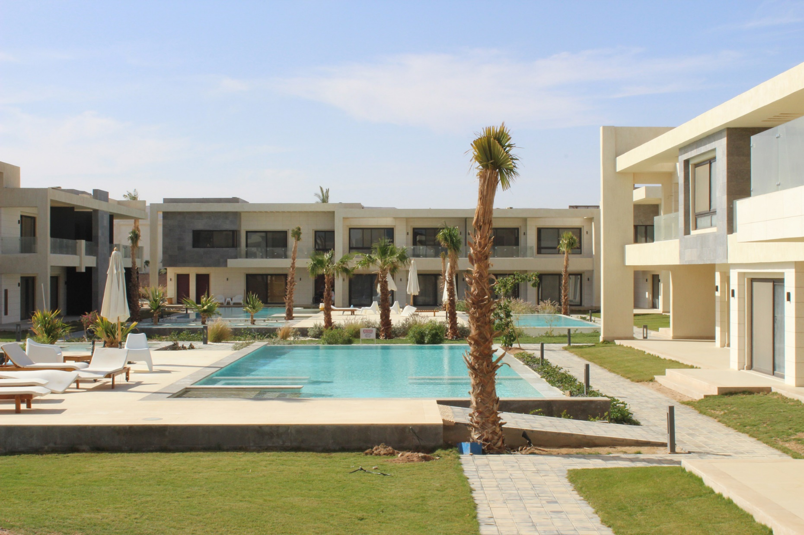
Construction Updates

Slide 35
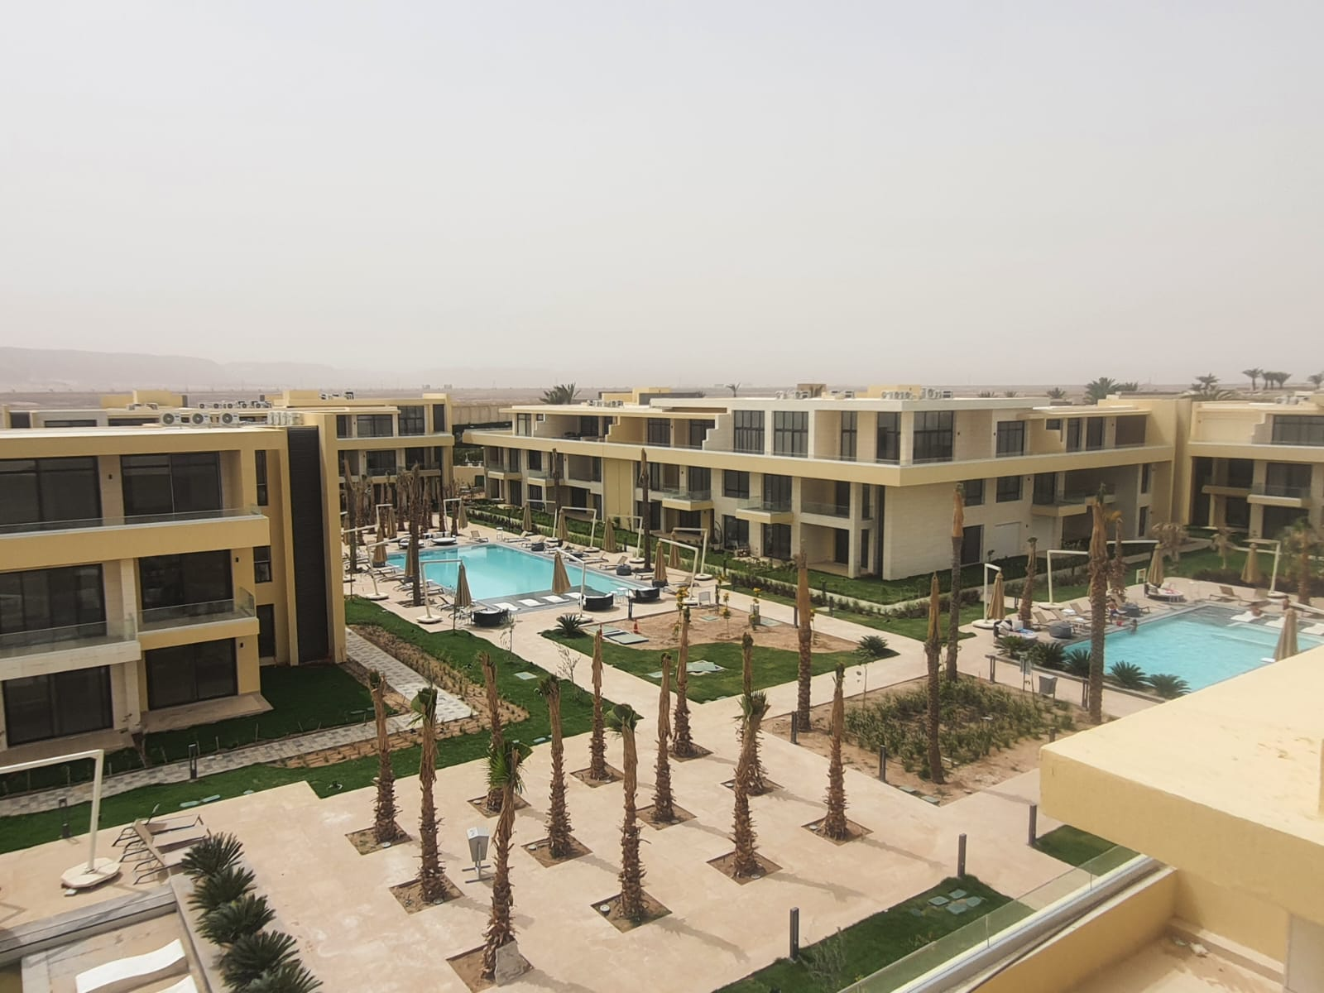
Construction Updates

Slide 36
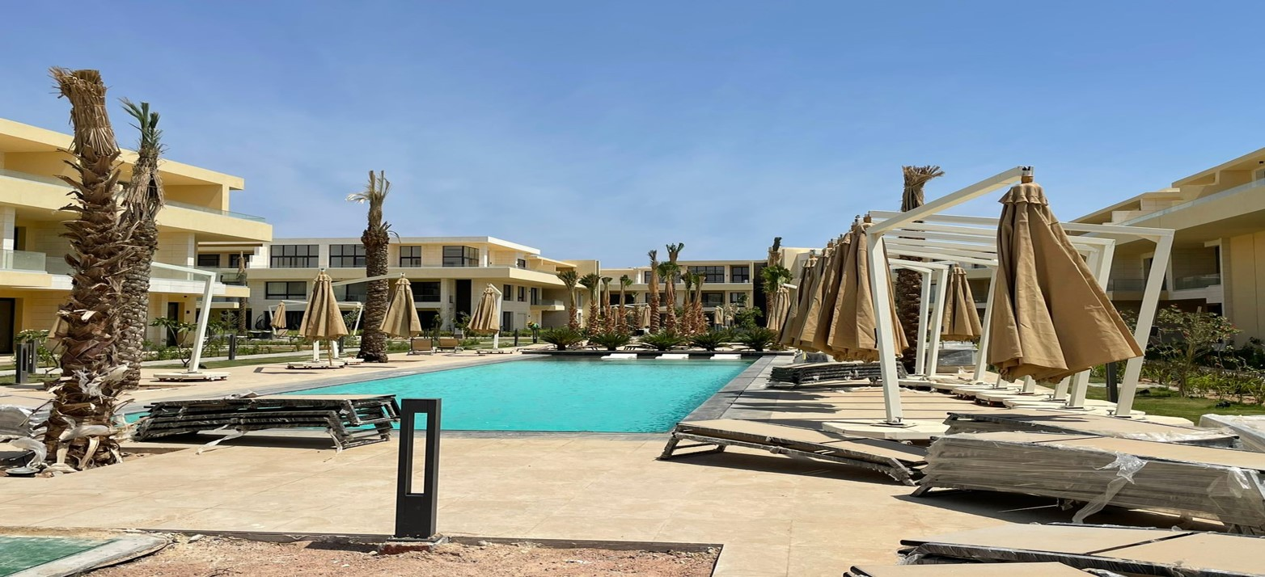
Construction Updates

Slide 37
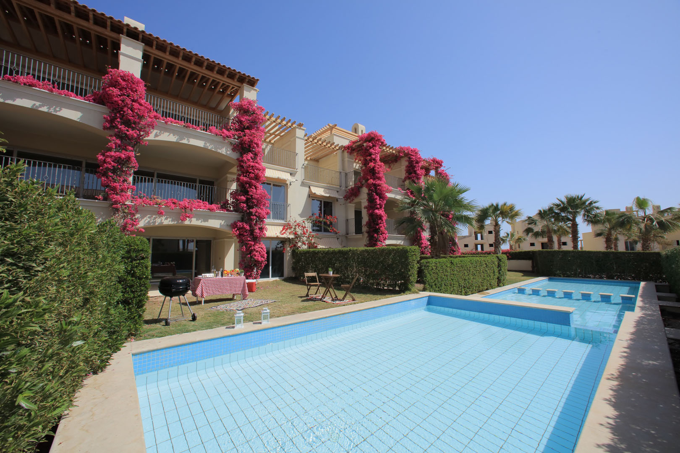
Veranda
Project Description :
Residential units (Array Studios, One & Two bedroom apartment & Villas.
Designed with a mélange of exotic gardens and surrounded by several lagoons.
Our scope of work :
Superior Finishes.
MEP including HVAC & FF systems.
Client: Inertia Properties
Location: Sahl Hasheesh, El-Gouna, Egypt.
Project value: Phase 1: 24 Million EGP
Phase 2: 23 Million EGP
Project status: (Delivered)

Slide 38
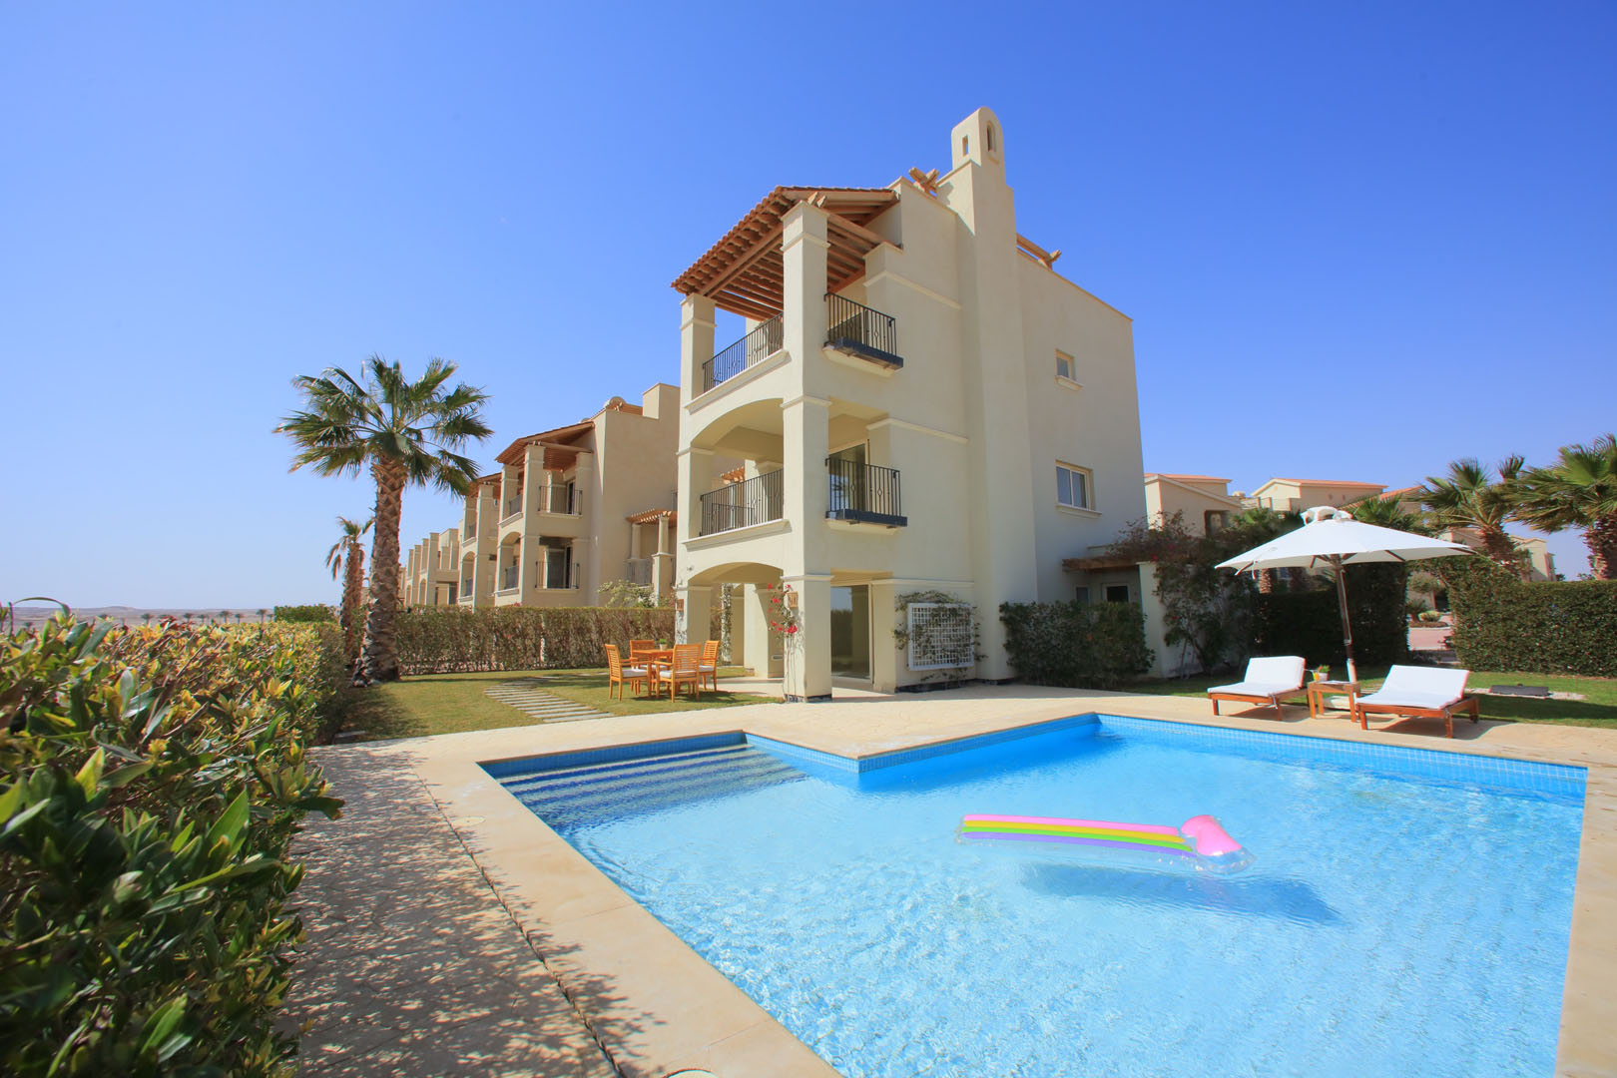
Construction Updates

Slide 39
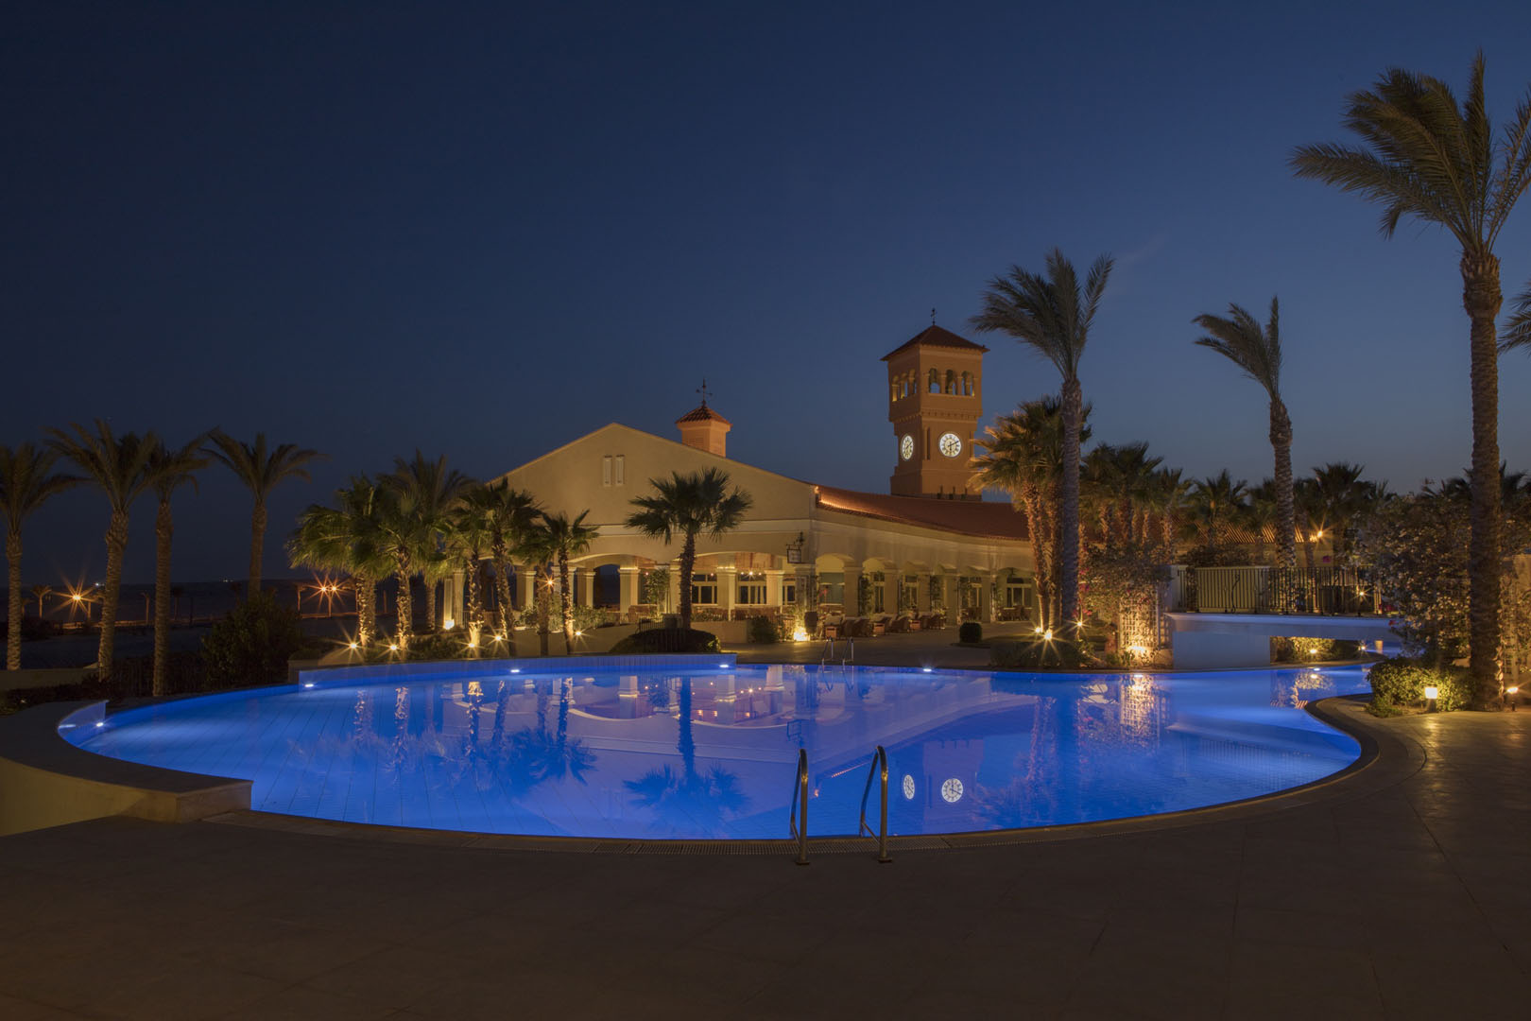
Construction Updates

Slide 40
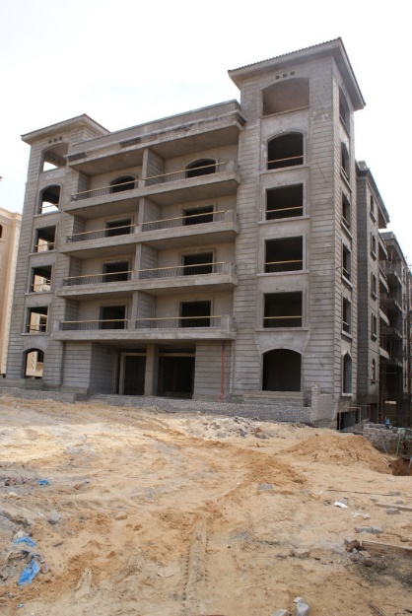
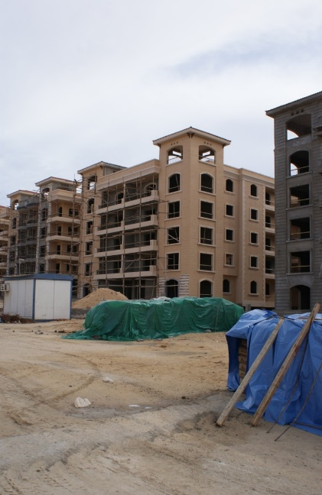
Diar Al Tameer, Residential Building
Project Description:
The project scope is to develop a residential apartment buildings in Diar Al Tameer residential compound.
Our scope of work : Construction for all project features
Sub and Super Structure.
Infrastructure & Utilities (Sewage).
MEP including HVAC & FF systems.
Client: Development and Engineering Consultant
Location: 6th of October, Egypt.
Project value: 12 Millions EGP
Project status: Delivered

Slide 41
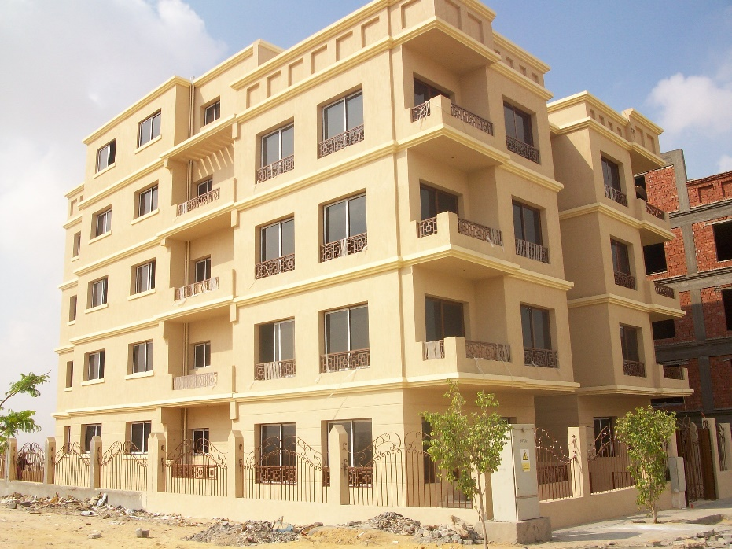
Beverly Hills Residence
Project Description:
Residential buildings within the Beverly Hills project
in El Sheikh Zayed City.
Our scope of work : Construction for all project features
Sub and Super Structure.
Infrastructure & Utilities (Sewage).
MEP including HVAC & FF systems.
Client: Inertia Properties
Location: 6th of October, Egypt.
Project value: 8 Millions EGP
Project Status: Delivered

Slide 42
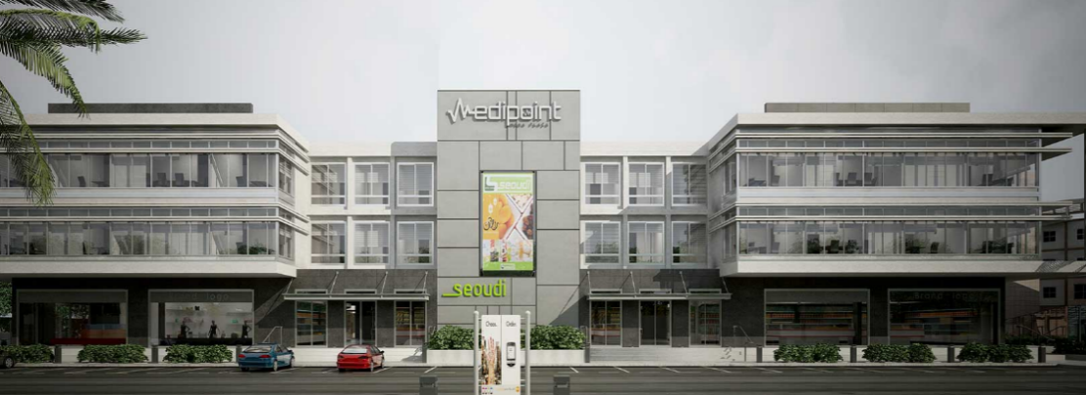
Medipoint 2
Project Description:
Medipoint Mena Plaza consists of two exquisitely designed three storey buildings. Within Inertia’s premise are two fully equipped medical floors and a dynamic commercial ground floor.
Our scope of work : Construction for all project features.
Infrastructure & Utilities (Sewage).
MEP including HVAC & FF systems.
Superior Finishes.
Client: Inertia Properties
Location: Sheikh Zayed City, Egypt
Project Value: 120 Million EGP
Project Status: ( Delivered )

Slide 43
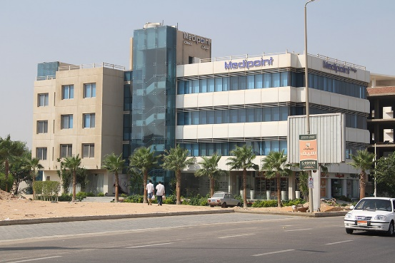
Medipoint
Project Description:
This project was a great opportunity since it increased the technical knowledge of our team concerning medical buildings requirements.
Our scope of work : Construction for all project features.
Infrastructure & Utilities (Sewage).
MEP including HVAC & FF systems.
Superior Finishes.
Client: Inertia Properties
Location: Sheikh Zayed City, Egypt
Project Value: 16 Million EGP
Project Status: Delivered

Slide 44

Intercontinental Semiramis Pavilion
Project Description:
The project is the renovation of the mezzanine floor for SEMIRAMIS hotel in downtown Cairo. The new project is more than 2000 m2, it includes:
- 6 meeting rooms.
- A gallery kitchen for receptions and business gatherings.
Rentable offices .
Libraries & business center.
Our scope of work: MEP including HVAC & FF systems, High-End Finishes
Client: SEMIRAMIS hotel /Consultant: EHAF Consulting Engineers/Toni Chi Architects, USA
Location: Cairo Egypt
Project value: 17 Million EGP
Project status: Delivered

Slide 45

Construction Updates

Slide 46

Construction Updates

Slide 47


Bloomberg
Our scope of work:
MEP
Fine Finishes
Security and AV Systems
Client: Bloomberg, project consultant: GLEEDS
Location: Zamalek, Cairo Egypt
Project value: 2 Million EGP
Project status: Delivered December 2014

Slide 48

Dogats
Project Description:
Dogtas furniture stores started in Turkey in 1972, operating in more than 20 countries around
the world. In 2012 Dogtas opened its first store in Egypt in Heliopolis. A luxury furniture
store on more than 1500 m2. To reflect the luxury of the furniture of Dogtas. The store was finished
in 60 days to meet the lunch time of the client.
Our scope of work: Finishes and MEP
Client: Quatro
Location: Giza,Egypt
Project value: 12 Million EGP
Project status: Delivered 2012

Slide 49


U.S Polo ASSN.
Project Description:
The project is 7 stores for well known American clothing brand that recently opened in Various locations all around Cairo.
Our scope of work:
MEP including HVAC & FF systems.
Superior Finishes.
Client: Quatro
Location: Egypt
Project Value: 500,000 EGP
Project Status: Delivered on December 2008

Slide 50


Becon Berlin
Project Description:
Interior finishes for the store as per the design by the client in tight time frame of one month.
Our scope of work:
MEP including HVAC & FF systems.
Superior Finishes.
Client : Quatro
Location: City Stars, Nasr City, Egypt.
Project Value: 400,000 EGP
Project Status: Delivered on December 2008

Slide 51

Emirates Office
Project Description:
The project is of great importance for the smooth Airport operation to Emirates crew.
Our scope of work:
MEP including HVAC & FF systems.
Superior Finishes.
Client: Emirates Airlines
Location: Cairo Airport, Cairo, Egypt.
Project Value: 500,000 EGP
Project Statues: Delivered

Slide 52



Community Activities

Slide 53

Inertia Construction participated in a charity project with Mashrou El Saada
-The project is to uplift a community school in Ayat in partnership with the NGO.
-The project impacts the students and the surrounding residents with the school being the central community space.
1. Painting the school interiors, exteriors and fence
2. Court area development to create a better seating area for the users and a play area for the children
3. Conducting different human empowerment activities for the children on the day of the event such as art sessions
4. Upgrading the existing library with needed furniture

Slide 54






Data Sheets

Slide 55





Marrafiq by INERTIA Construction was the main sponsor of the new life changing event that will be held in Qursayah Island by Mashrou El Saada (NGO).
This development project aims to unleash the potential of the marginalized local community of Qursayah through creating a node/ hub for the connection between the locals and external relevant networks and resources. The main purpose of this project is to improve the island by developing it into a HUB and locally manufactured products to generate income in the island.

Slide 56



Linchpin-Heft by INERTIA Construction was the main sponsor of the Biggest Virtual Event in Egypt and the Middle East.
The first Online virtual football event, which provides a live session with the football legends Del Piero and Hazim Emam

Slide 57




Contact
For any inquiries or questions, please reach out to us at:
Email
companyname@gmail.com
Phone
+ 0123 456 789
Office Address
Building A - Al Karma District 4, Entrance 2
1ST Floor, El Sheikh Zayed City, Giza - Egypt

